Slide 1
Sex & Age Online
Chapter 3
SofieAndreou.com @SofieAndreou #SofieMarketingTips

Slide 2
Sex & Age Online
One message and one medium does NOT appeal to everyone. Do NOT take ONE message and repurpose it through your chosen Social Media platforms to your target markets.
@SofieAndreou Opening Lecture #SofieMarketingTips

Slide 3
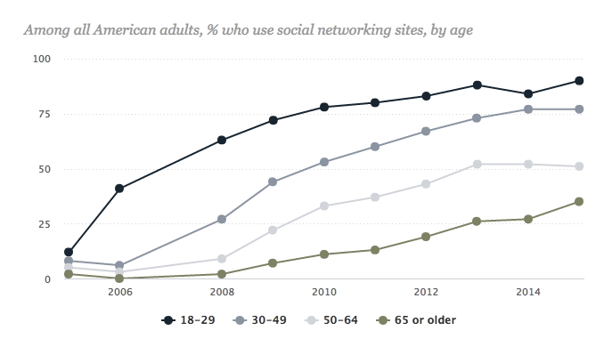
Sex & Age Online
@SofieAndreou Opening Lecture #SofieMarketingTips

Slide 4
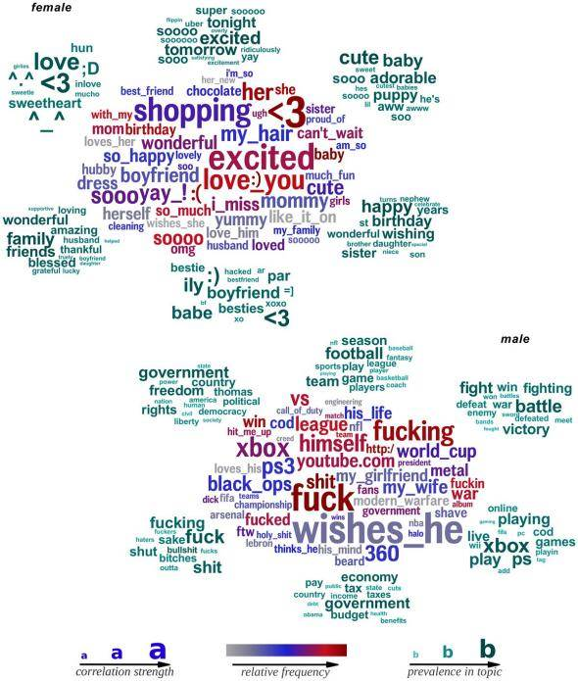
Sex & Age Online
@SofieAndreou Opening Lecture #SofieMarketingTips

Slide 5
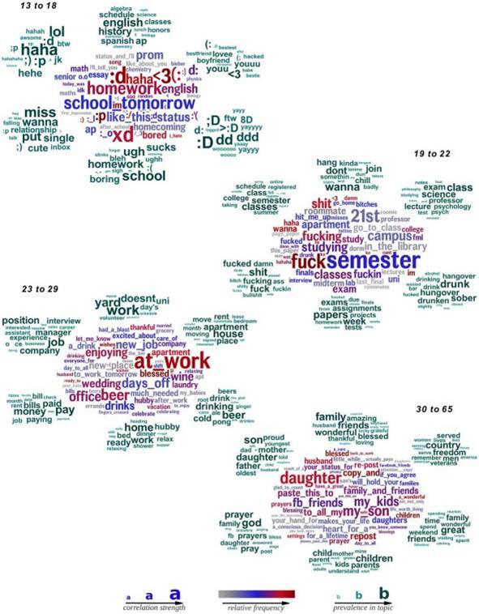
Sex & Age Online
@SofieAndreou Opening Lecture #SofieMarketingTips

Slide 6
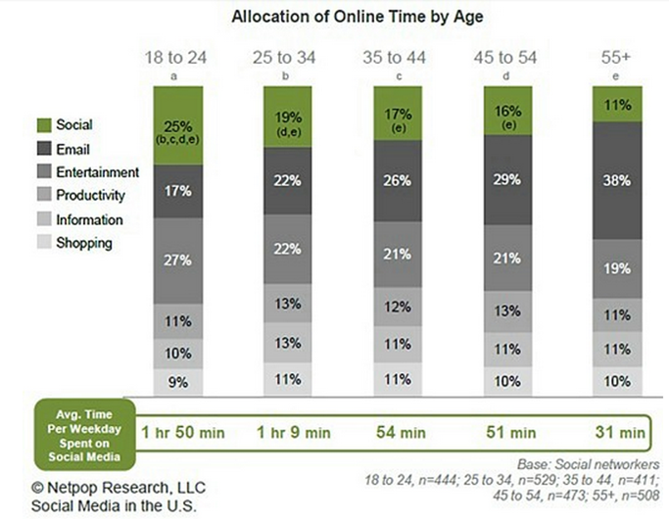
Sex & Age Online
@SofieAndreou Opening Lecture #SofieMarketingTips

Slide 7
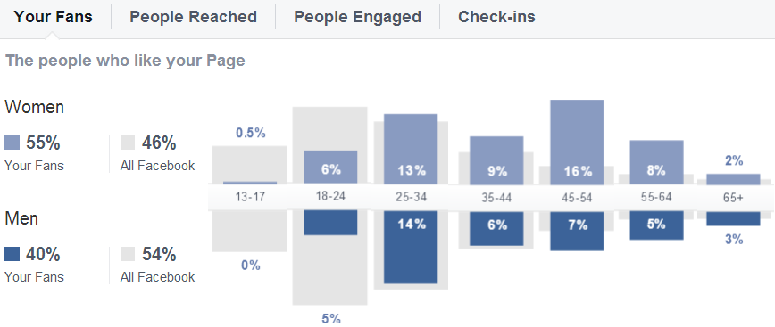
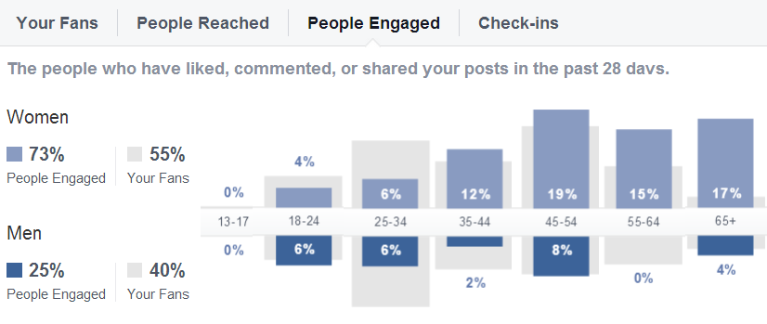
Sex & Age Online
@SofieAndreou Opening Lecture #SofieMarketingTips

Slide 8
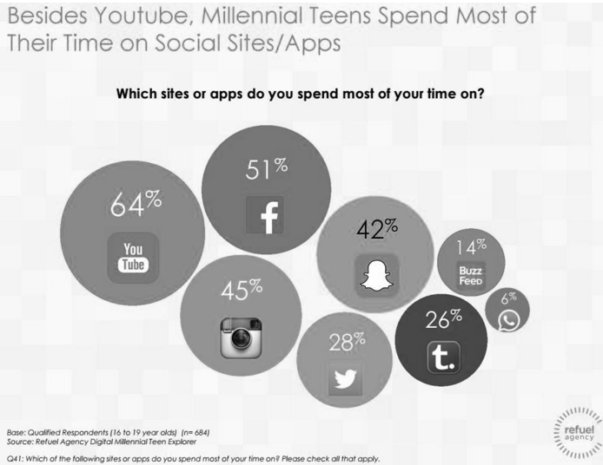
Millennials Online
@SofieAndreou Opening Lecture #SofieMarketingTips

Slide 9
Millennials Online
Millennial demographic characteristics chart
An important behaviour of Millennials to recognize is their drive for
transparency and their purchase behaviours. 84% report that user
generated content on a company website somewhat influences what
they buy, and 63% stay updated on brands they’re interested in
through social networks.
Interesting to note, the top purchases Millennials won’t complete
without user-generated content, include:
Major electronics
Cars
Hotels
Travel
Credit cards
Insurance
@SofieAndreou Opening Lecture #SofieMarketingTips

Slide 10
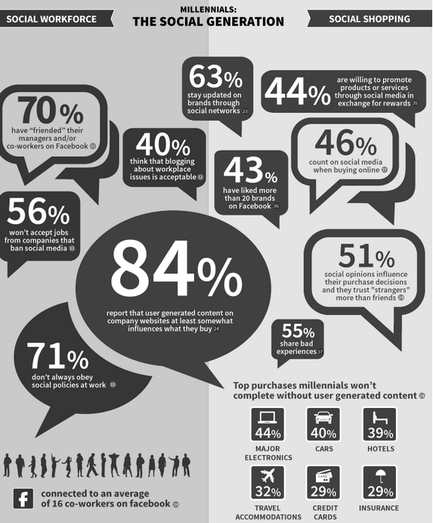
Millennials Online
@SofieAndreou Opening Lecture #SofieMarketingTips

Slide 11
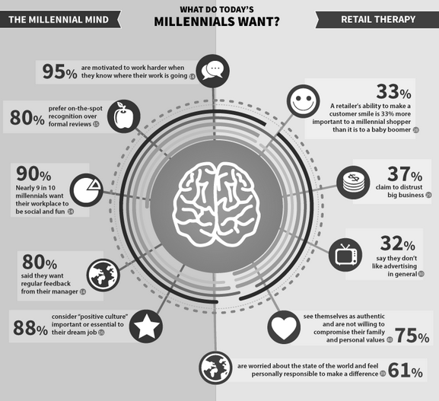
Millennials Online
@SofieAndreou Opening Lecture #SofieMarketingTips

Slide 12
Sex & Age Online
1993/2001 - Present - New Silent Generation or Generation Z 1980-2000 - Millennials or Generation Y, 27.4 % of our population 1965-1979 - Generation X, 26.6% of our population 1946-1964 - Baby Boom, 26.4 % of our population 1925-1945 - Silent Generation, 13% of our population 1900-1924 - G.I. Generation, 4.4% of our population
@SofieAndreou Opening Lecture #SofieMarketingTips

Slide 13
Sex & Age Online
1. 93% of baby boomers are actively using email, and 61% of them use it on a daily basis.
Takeaway: Email marketing is a smart way to reach baby boomers and to successfully place information in front of them.
2. 76% of baby boomers are actively online.
Takeaway: With more and more baby boomers moving online, marketers can take advantage of a new platform to share content with them.
3. 75% of baby boomers buy products online.
Takeaway: When marketing to baby boomers, present them with deals that direct them online instead of requiring in-store purchases.
4. Only 55% of baby boomers (55-64) watch videos online, compared to 80% of Millennials.
Takeaway: When creating video assets, be mindful of whom you’re trying to reach and make sure it’s the right fit.
5. 43% of baby boomers are on social media sites. Of that 43%, 20% visit social media sites on a daily basis.
Takeaway: Even though the majority of baby boomers aren’t on social media, close to half of them are. Don’t automatically throw out online campaigns to reach them.
6. 85% of people ages 30-39 open emails on their smartphones, and 48% say it’s their primary device for doing so.
Takeaway: Marketers trying to reach 30-39 year olds through email should keep it short and simple with graphics that are mobile friendly.
7. 56% of consumers between the ages 18-34 are more likely to share their location to receive coupons from local businesses. 25% also said that they would give away personal information to get more relevant deals, compared with 19% of the 35 and over group.
Takeaway: Marketers that want to use geo-targeted check-in apps should be cautious of the amount of information they require from specific age groups.
8. 90% of Millennials have a mobile phone, and more than half of them have a smartphone.
Takeaway: When marketing to Millennials, make sure all of your platforms are mobile friendly.

Slide 14
Sex & Age Online
9. Millennials are 52% more likely than any other generation to make impulse buys.
Takeaway: Because Millennials are so impulsive, it would make sense to send them last-minute mobile deals or to place social ads that require them to act immediately.
10. 64% of Millennials feel that companies should offer more ways to share their opinions online.
Takeaway: Millennials like sharing their opinion and want to feel like their voice is being heard. By allowing them to review your product, you’re creating a more transparent brand and the demographic will trust your company more.
11. 78% of teens, ages 12-17, now own a cell phone, and 47% of those teens own a smartphone.
Takeaway: Mobile marketing isn’t just for Millennials anymore. There is a large demographic that now has access to smartphones and mobile capabilities.
12. 24% of teens online use Twitter, up from only 16% in 2011.
Takeaway: With more and more teens taking to Twitter, there’s an opportunity for brands with younger target audiences to maximize the platform’s capabilities.
@SofieAndreou Opening Lecture #SofieMarketingTips

Slide 15
Generation Z Online
Characteristics. According to Forbes (2015), the generation after Millennials,
Generation Z, which they defined as people born from the
mid 1990s to the early 2000s, made up 25% of the U.S. population,
making them a larger cohort than the Baby Boomers or Millennials.
@SofieAndreou Opening Lecture #SofieMarketingTips

Slide 16

A Shift to Targeting Generation Z
Social Media Marketing Tactics to Target Gen Z:
Integrate them into your brand; help them build their personal brand while you promote yours. Encourage them to be social influencers.
Be as authentic as possible. Take spontaneous photos and videos. Give consumers a look behind the scenes of your company. Choose a spokesperson to whom Gen Z can relate.
Focus on YOUR social influence. You need to have a quality product or service to convince people to love it. Once that happens, you’ll have influencers that are sure to impress Generation Z.
Walk the talk. Don’t only say your company does great things for the community or focuses on philanthropy; you have to show and prove your acts of generosity. Work social good into your business strategy.
@SofieAndreou Opening Lecture #SofieMarketingTips

Slide 17
A Shift to Targeting Generation Z
Overall, Gen Z is innovative, phone-obsessed, and they crave authentic experiences.
They're conscious about the environment.
Choose visuals over text.
They prefer incognito social media platforms that their parents and grandparents aren’t on.
@SofieAndreou Opening Lecture #SofieMarketingTips

Slide 18
A Shift to Targeting Generation Z
Prepare your Board, Staff, & The Boss
Enlist the help of Gen Z to provide videos, images and stories that truly convey the power of your good work.
@SofieAndreou Opening Lecture #SofieMarketingTips

Slide 19

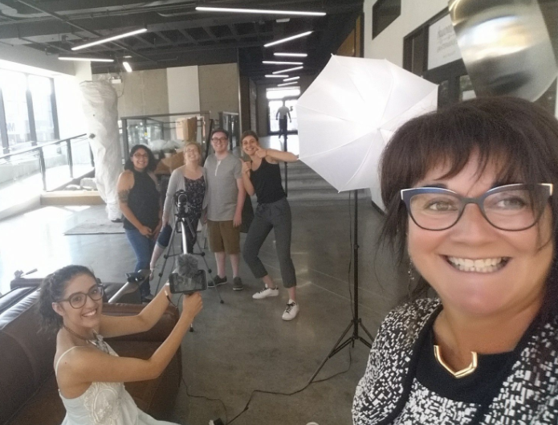
Work with Gen Z – Learn From Each Other
@SofieAndreou Opening Lecture #SofieMarketingTips

Slide 20

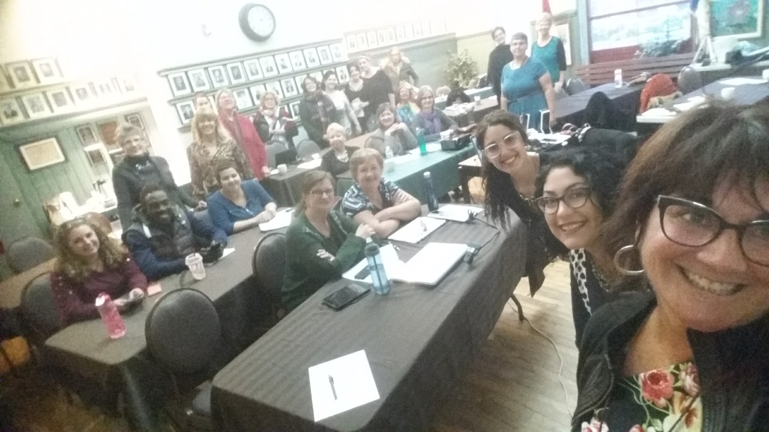
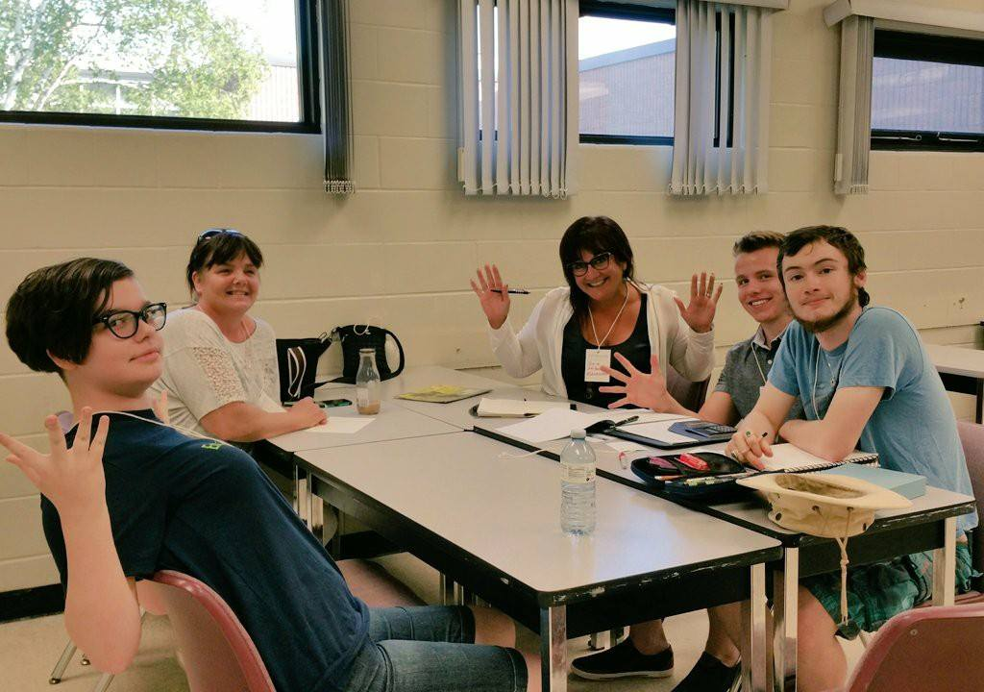
Stepping It Up With
Working with Gen Z
@SofieAndreou Opening Lecture #SofieMarketingTips

